Slide 1
Object Oriented Programming—C++ Lecture05 Classes (I)
Qijun Zhao
College of Computer Science
Sichuan University
Spring 2025

Slide 2
Contents
1. C++ Classes Introduction
1.1 class vs. struct
1.2 Data members and Function Members
2. Class Hierarchy
2.1 Access Specifiers
2.2 Inheritance Access Specifiers
3. Class Constructor and Destructor
3.1 Introduction
3.2 Default Constructor
3.3 Class Initialization
3.4 Constructors and Inheritance
3.5 Delegate Constructor
3.6 explicit Keyword
3.7 Copy Constructor
3.8 Move Constructor

Slide 3
1. C++ Classes Introduction
1.1 class vs. struct
C/C++ Structure
A structure (struct) is a collection of variables of the same or different data types under a single name
C++ Class
A class (class) extends the concept of structure to hold functions as members
struct vs. class
Structures and classes are semantically equivalent. In general, struct represents passive objects, while class active objects

Slide 4
1.2 Class Members - Data and Function Members
Data Member
Data within a class are called data members or class fields
Function Member
Functions within a class are called function members or methods

Slide 5
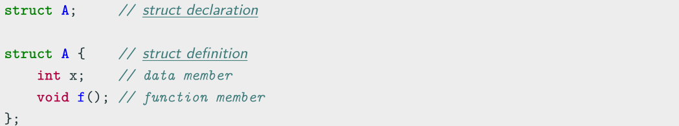
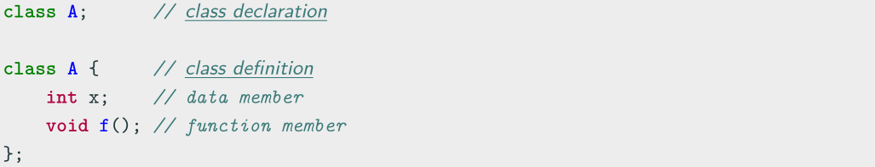
struct/class Declaration and Definition
struct declaration and definition
class declaration and definition

Slide 6
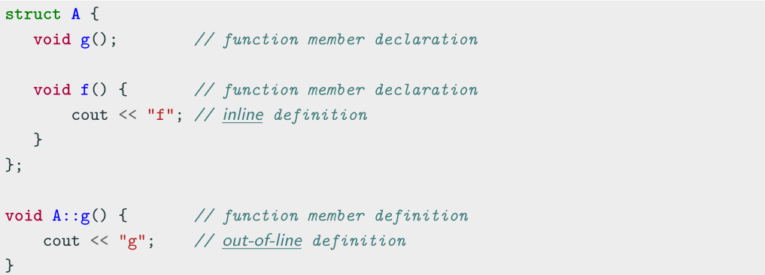
struct/class Function Declaration and Definition
Notes:
普通函数在编译后会被放置在代码段，在运行时，通过函数调用的方式来执行，这涉及到参数压栈、函数调用地址的寻址、函数执行后的返回值保存和出栈操作，这个过程会有一定的开销。
内联函数则在编译时将函数的代码直接复制到调用处，这样在运行时就不需要进入函数调用的开销，因此内联函数可以提高执行效率。
另外，内联函数的使用有一定的限制，如果内联函数的函数体过于复杂，编译器可能会自动将其视为普通函数来处理。而且，内联函数在提高效率的同时，也意味着代码的膨胀，可能会增加内存消耗。

Slide 7
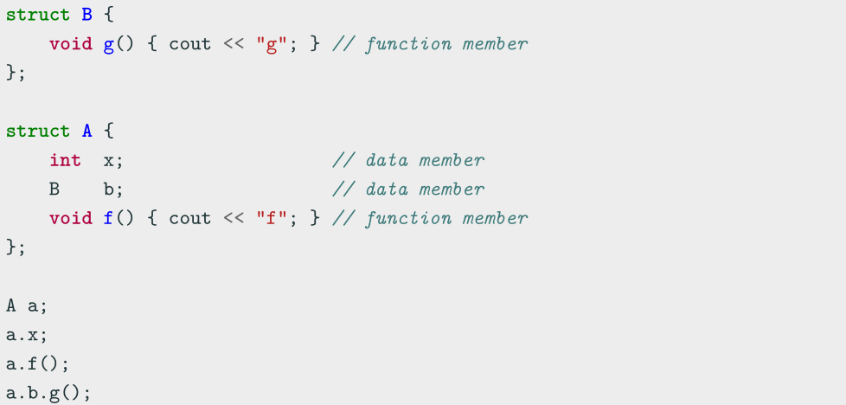
struct/class Members

Slide 8
2. Class Hierarchy
Child/Derived Class or Subclass
A new class that inherits variables and functions from another class is called a derived or child class
Parent/Base Class
The closest class providing variables and functions of a derived class is called parent or base class
Extending a base class refers to creating a new class which retains characteristics of the base class and on top it can add (and never remove) its own members

Slide 9
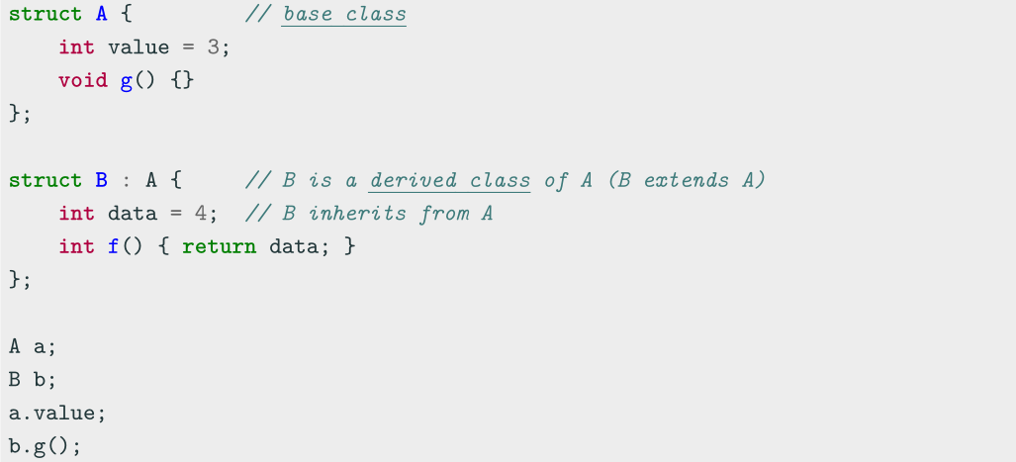
Class Hierarchy

Slide 10
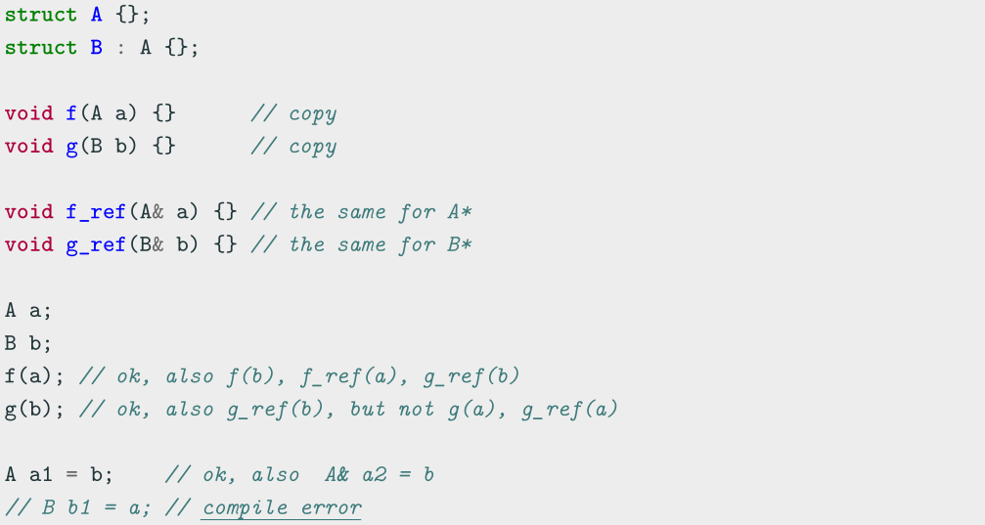
Class Hierarchy
Notes:
父类可以接受子类，但子类不能接受父类

Slide 11
2.1 Access specifiers
The access specifiers define the visibility of inherited members of the subsequent base
class. The keywords public , private , and protected specify the sections of visibility
The goal of the access specifiers is to prevent a direct access to the internal
representation of the class for avoiding wrong usage and potential inconsistency
(access control)
• public: No restriction (function members, derived classes, outside the class)
• protected: Function members and derived classes access
• private: Function members only access (internal)
struct has default public members
class has default private members

Slide 12
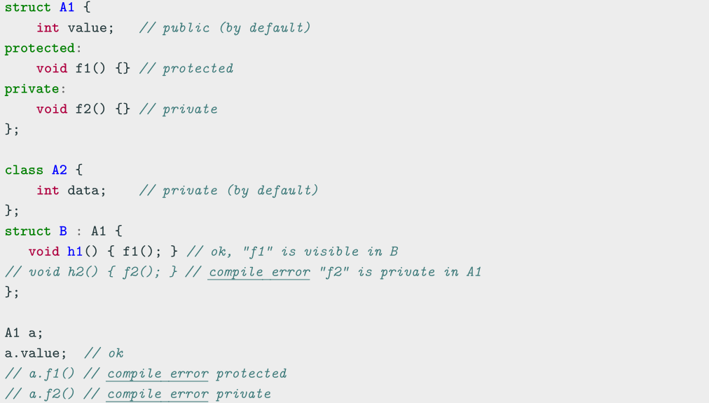
Access specifiers

Slide 13
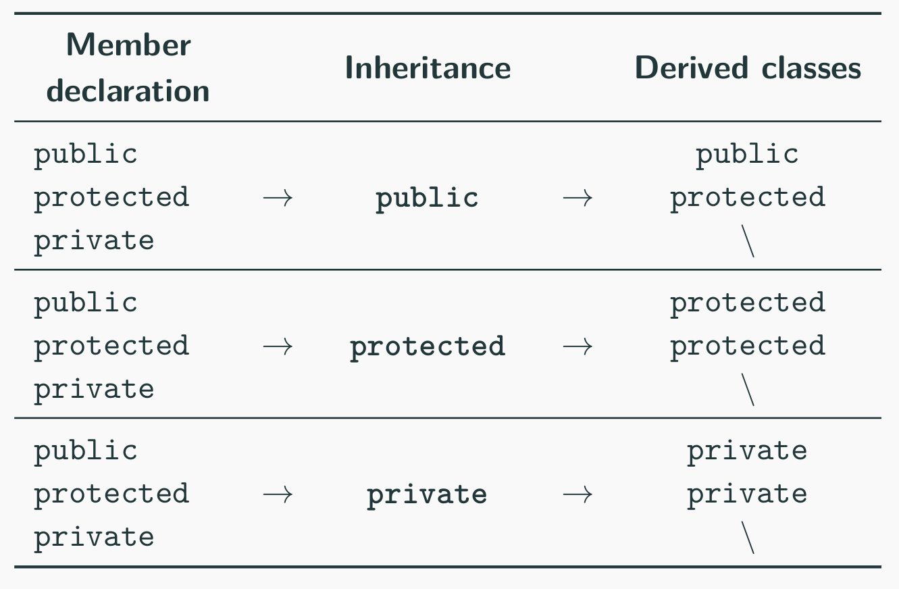
2.2 Inheritance Access Specifiers
The access specifiers are also used for defining how the visibility is propagated from the base class to a specific derived class in the inheritance

Slide 14
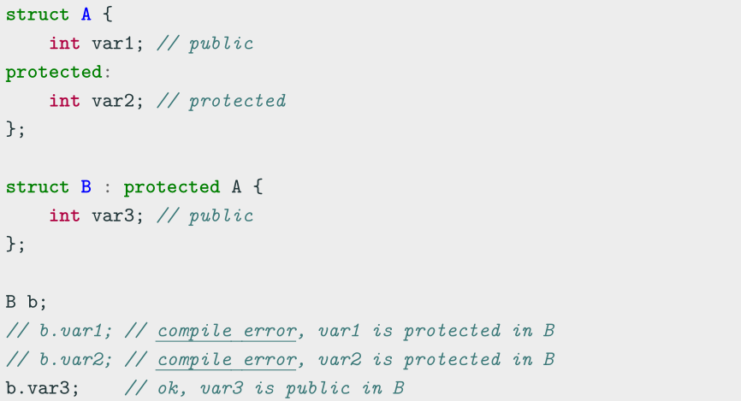
Inheritance Access Specifiers

Slide 15
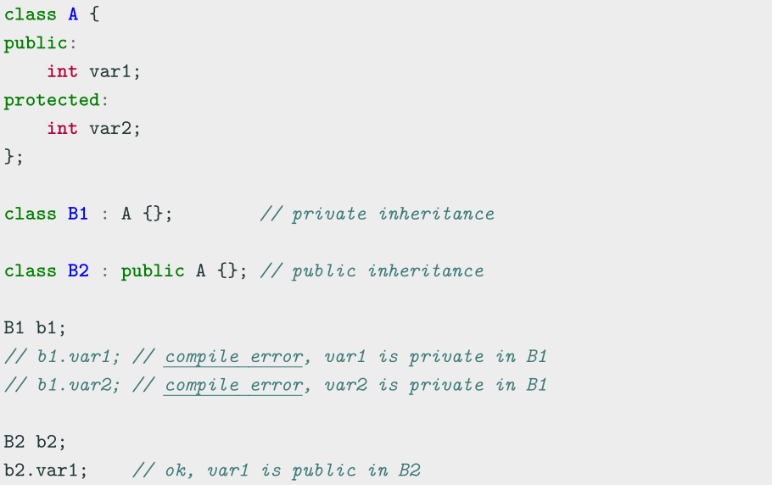
Inheritance Access Specifiers

Slide 16
3. Class Constructor and Destructor
3.1 Introduction
Constructor [ctor]
A constructor is a special member function of a class that is executed when a new instance of that class is created Goals: initialization and resource acquisition Syntax: T(...) same named of the class and no return type
• A constructor is supposed to initialize all data members
• We can define multiple constructors with different signatures
• Any constructor can be constexpr
Notes:
constexpr表达式是指值不会改变，并且在编译过程中就能得到计算结果的表达式。
如果使用constexpr定义了一个指针，那么constexpr只是针对指针有效，与指针所指的对象无关。

Slide 17
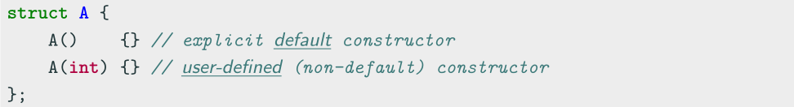
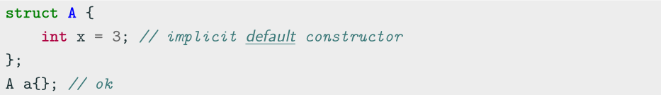
3.2 Default Constructor
Default Constructor
The default constructor T() is a constructor with no argument
Every class has always either an implicit or explicit default constructor
• An implicit default constructor is constexpr

Slide 18
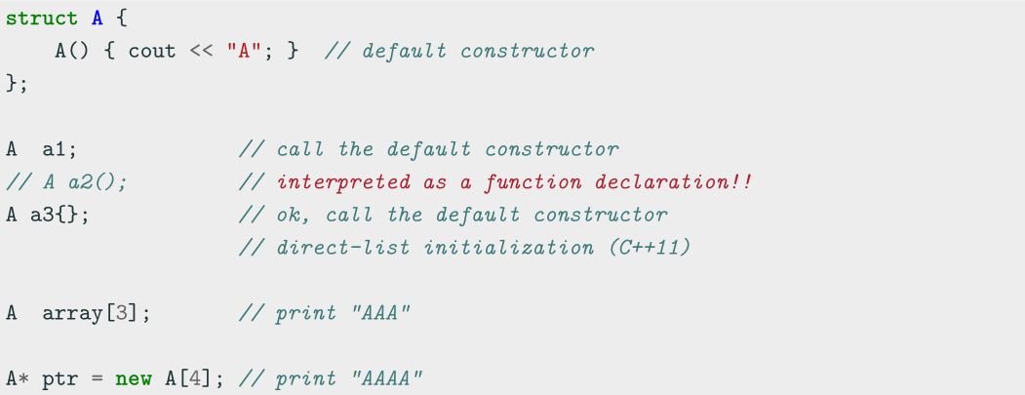
Default Constructor Examples

Slide 19
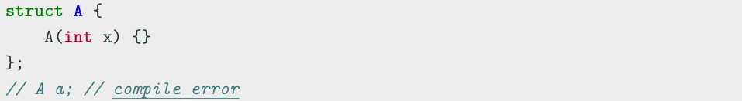
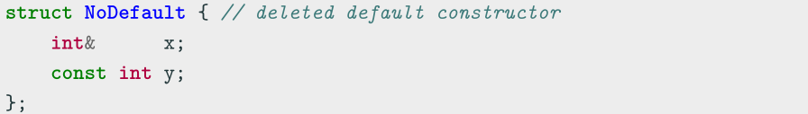
Deleted Default Constructor
The implicit default constructor of a class is marked as deleted if (simplified):
It has any user-defined constructor
It has a non-static member/base class of reference/const type

Slide 20
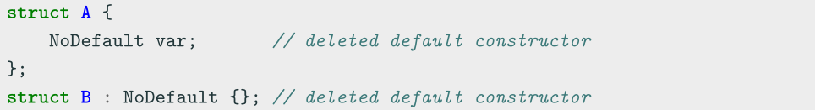
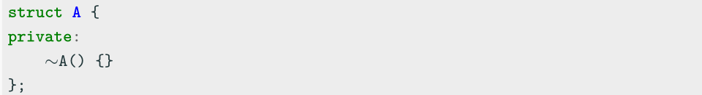
Deleted Default Constructor
It has a non-static member/base class which has a deleted (or inaccessible) default constructor
It has a non-static member/base class with a deleted or inaccessible destructor

Slide 21
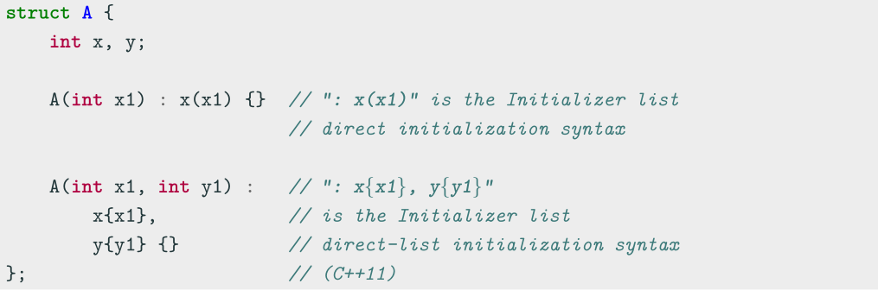
3.3 Class Initialization
3.3.1 Initializer List
The Initializer list is used for initializing the data members of a class or explicitly call
the base class constructor before entering in the constructor body
(Not to be confused with std::initializer_list )

Slide 22
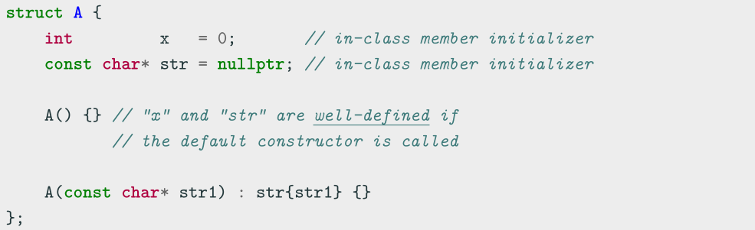
3.3.2 In-Class Member Initializer
C++11 In-class non-static data members can be initialized where they are declared
(NSDMI). A constructor can be used when run-time initialization is needed

Slide 23
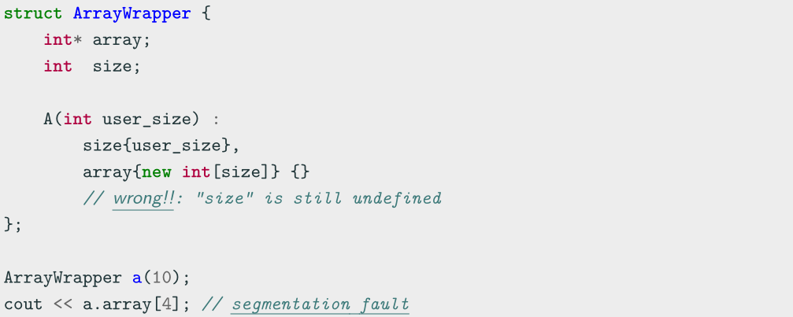
3.3.3 Initialization Order
Class members initialization follows the order of declarations and not the order in the
initialization list

Slide 24
3.3.4 Uniform Initialization
Uniform Initialization ( C++11 )
Uniform Initialization {}, also called list-initialization, is a way to fully initialize any object independently from its data type
Minimizing Redundant Typenames
- In function arguments
- In function returns
Solving the “Most Vexing Parse” problem
- Constructor interpreted as function prototype

Slide 25
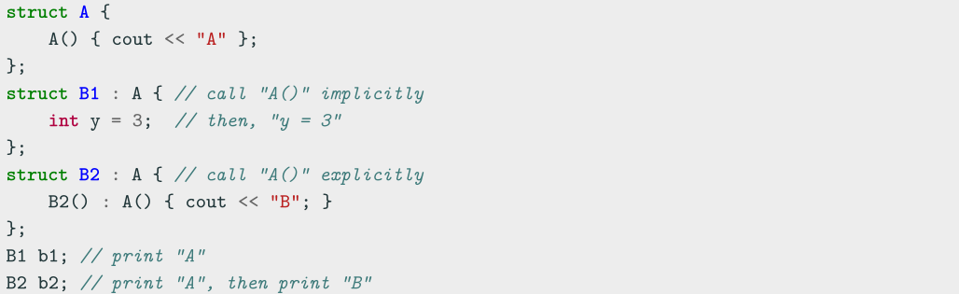
3.4 Constructors and Inheritance
Class constructors are never inherited
A Derived class must call implicitly or explicitly a Base constructor before the current
class constructor
Class constructors are called in order from the top Base class to the most
Derived class (C++ objects are constructed like onions)

Slide 26
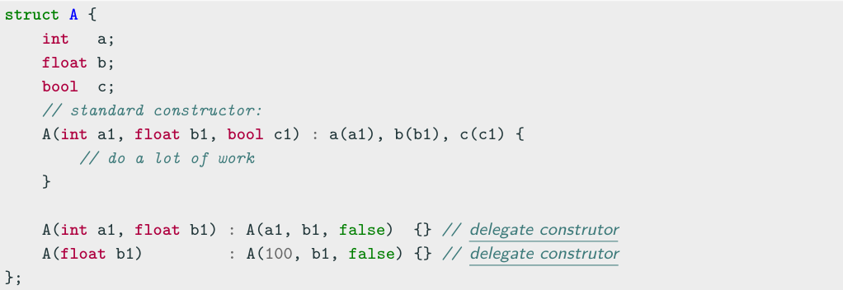
3.5 Delegate Constructor
The problem:
Most constructors usually perform identical initialization steps before executing
individual operations
C++11 A delegate constructor calls another constructor of the same class to reduce
the repetitive code by adding a function that does all of the initialization steps

Slide 27
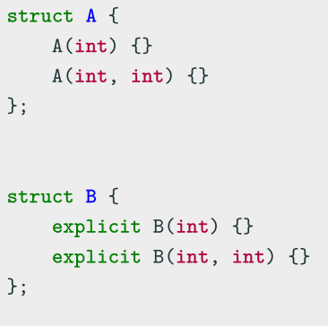
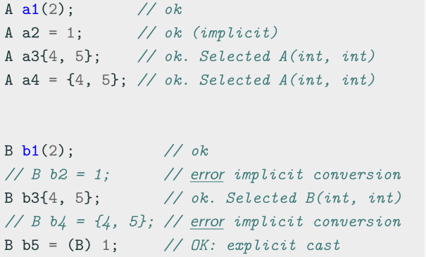
3.6 explicit Keyword
explicit
The explicit keyword specifies that a constructor or conversion function (C++11) does not allow implicit conversions or copy-initialization

Slide 28
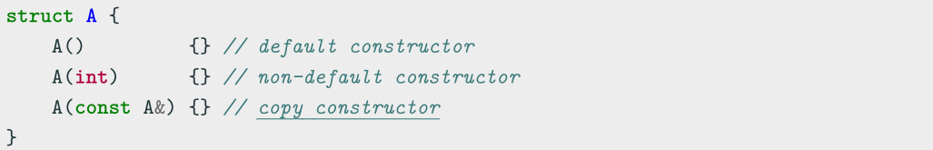
3.7 Copy Constructor
Copy Constructor
A copy constructor T(const T&) creates a new object as a deep copy of an existing object
Every class always defines an implicit or explicit copy constructor
Even the copy constructor implicitly calls the default Base class constructor
Even the copy constructor is considered a non-default constructor

Slide 29
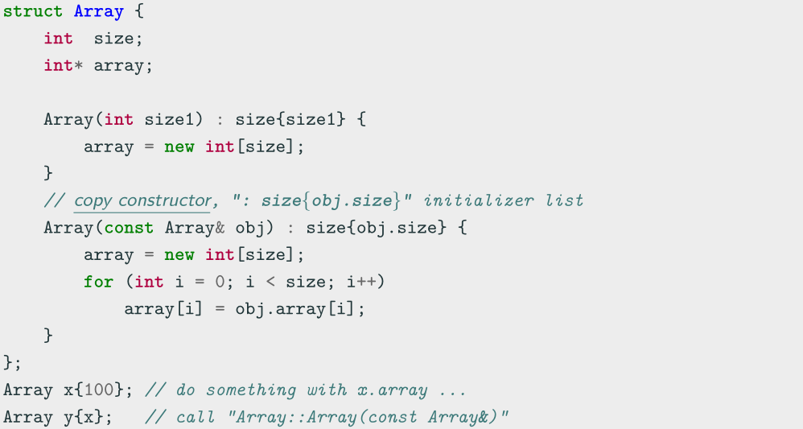
Copy Constructor Example

Slide 30
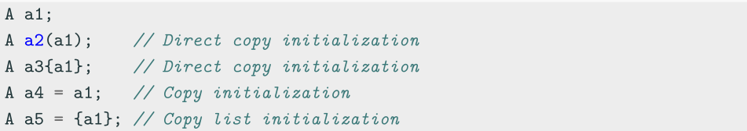
Copy Constructor Usage
The copy constructor is used to:
Initialize one object from another one having the same type
- Direct constructor
- Assignment operator
Copy an object which is passed by-value as input parameter of a function
Copy an object which is returned as result from a function

Slide 31
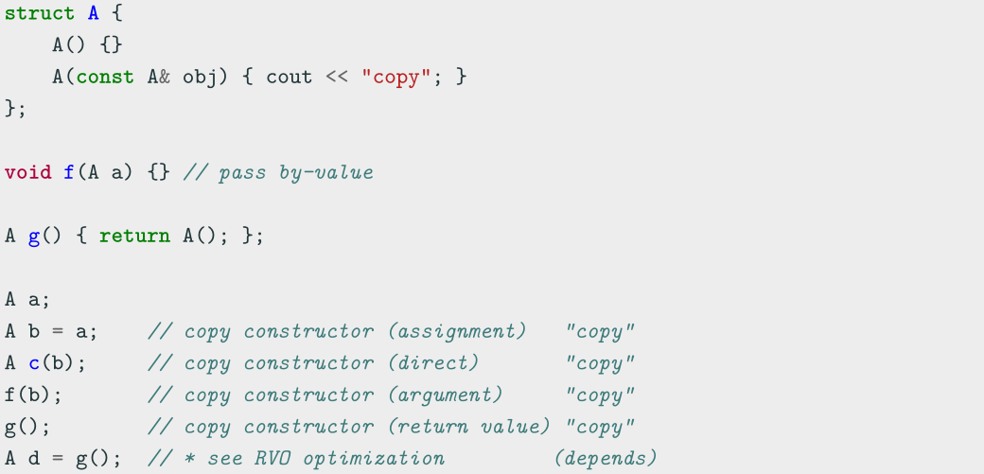
Copy Constructor Usage Examples

Slide 32
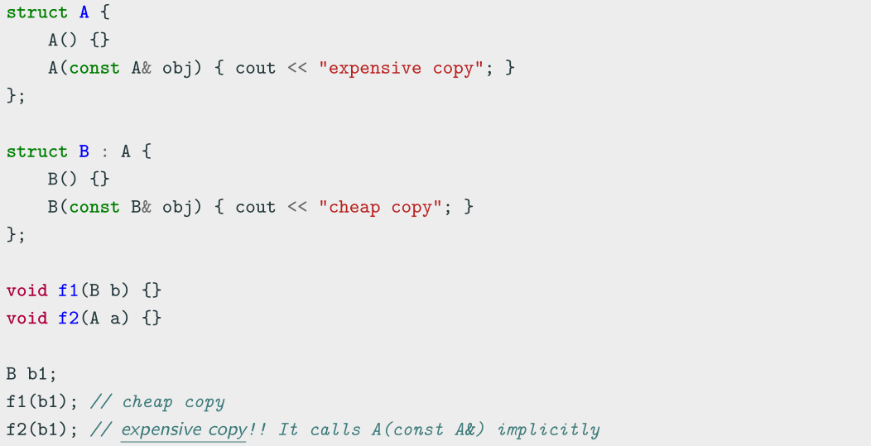
Pass by-value and Copy Constructor

Slide 33
3.8 Move Constructor
Is copying enough?
We’ve learned about the default constructor, destructor, and the copy constructor and assignment operator.
● We can create an object, get rid of it, and copy its values to another object!
● Is this ever insufficient?

Slide 34
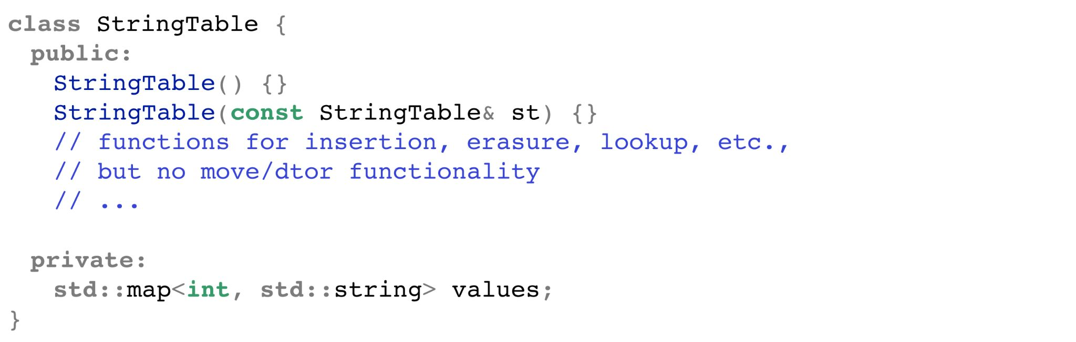
This can be wasteful!
Let's say we had to copy our current StringTable into another, whose reference is
given to us, and we have no use for our StringTable afterwards.
The copy constructor will
copy every value in the
values map one by one!
Very slowly!

Slide 35
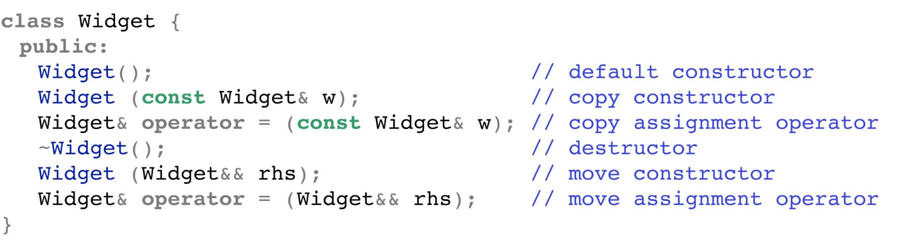
There are six special member functions!
These functions are generated only when they're called (and
before any are explicitly defined by you):
Let’s talk about it now!

Slide 36
Move operations
● Move constructors and move assignment operators will
perform "memberwise moves."
● Defining a move assignment operator prevents generation of a move copy constructor, and vice versa.
○ If the move assignment operator needs to be re-implemented, there'd likely be a problem with the move constructor!
Unlike copy operations!

Slide 37
Caveats
Move constructors and operators are only generated if:
● No copy operations are declared
● No move operations are declared
● No destructor is declared
Declaring any of these will get rid of the default C++ generated operations.

Slide 38
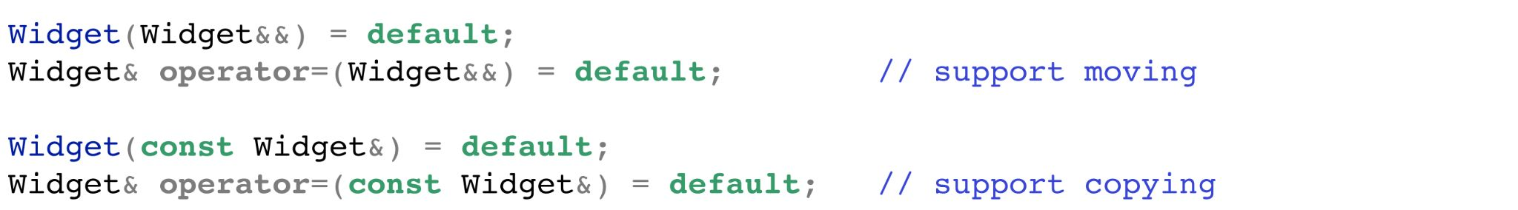
Caveats
If we want to explicitly support move operations, we can set the operators to default:
???

Slide 39
Coding to make the world better
Qijun Zhao
qjzhao@scu.edu.cn

